Slide 1
19CSE456- NEURAL NETWORKS & DEEP LEARNING

Slide 2
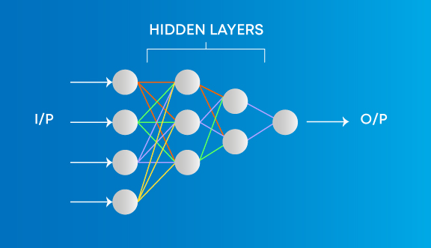
Types of Neural Networks
Multilayer Perceptron
The simplest form of neural networks.
Every single node is connected to all neurons in the next layer
Input and output layers are present having multiple hidden Layers
Advantages
Used for deep learning [due to the presence of dense fully connected layers and back propagation]
Disadvantages
Comparatively complex to design and maintain

Slide 3
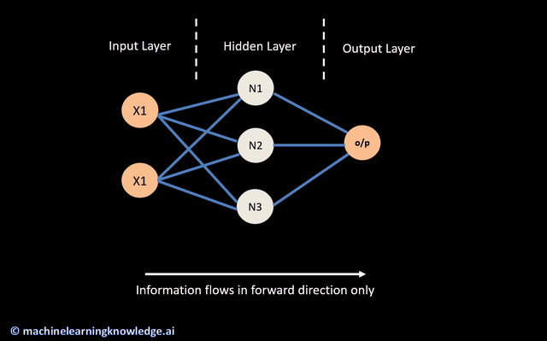
Multilayer Perceptron
It is a neural network where the mapping between inputs and output is non-linear.
Inputs are combined with the initial weights in a weighted sum and subjected to the activation function.
Each linear combination is propagated to the next layer
The neurons in the neural network are connected to each other by weights.
Apart from weights, each neuron also has its own bias.

Slide 4
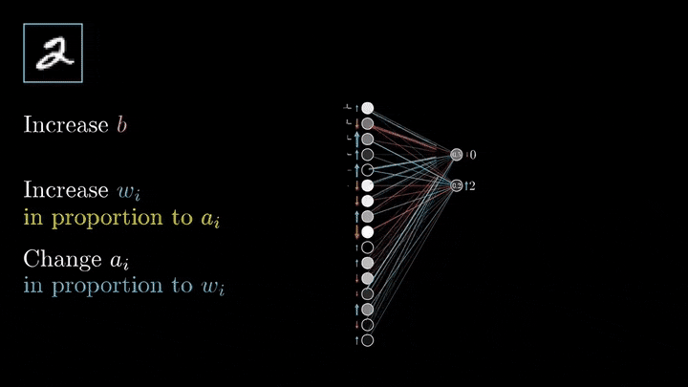
Multilayer Perceptron-Training
Training involves adjusting the parameters, or the weights and biases, of the model to minimize error
Learning happens in two ways
Forward Propagation:
In the forward pass, the signal flow moves from the input layer through the hidden layers to the output layer, and the decision of the output layer is measured against the ground truth labels. And then will find error against ground truth and true label.
Back-propagation:
It is the practice of fine-tuning the weights of a neural net based on the error rate (i.e. loss) obtained in the previous epoch (i.e. iteration). Proper tuning of the weights ensures lower error rates, making the model reliable by increasing its generalization.

Slide 5
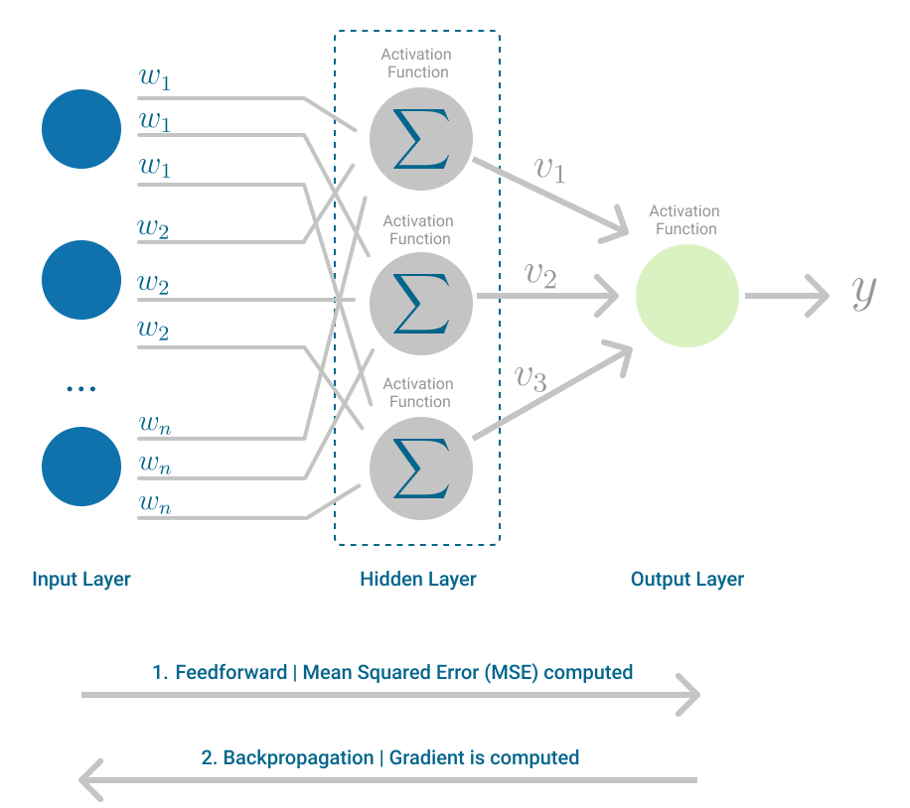
Back Propagation
Learning mechanism that allows the Multilayer Perceptron to iteratively adjust the weights in the network, with the goal of minimizing the cost function.
The activation function should be differentiable

Slide 6

Back Propagation

Slide 7
Back Propagation
In each iteration, after the weighted sums are forwarded through all layers, the gradient of the Mean Squared Error is computed across all input and output pairs.
The weights of the first hidden layer are updated with the value of the gradient.
Optimizers are used to update the weights:
Gradient Descent
Stochastic Gradient Descent (SGD)
Mini-Batch Gradient Descent
Momentum
Adam
Optimizers are algorithms or methods used to change the attributes of your neural network such as weights and learning rate in order to reduce the losses.
Responsible for reducing the losses and to provide the most accurate results possible.

Slide 8
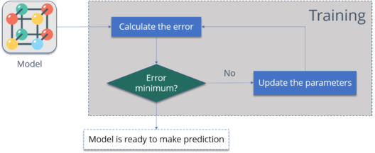
Back Propagation
Calculate the error – How far is your model output from the actual output.
Minimum Error – Check whether the error is minimized or not.
Update the parameters – If the error is huge then, update the parameters (weights and biases). After that again check the error. Repeat the process until the error becomes minimum.
Model is ready to make a prediction – Once the error becomes minimum, you can feed some inputs to your model and it will produce the output.

Slide 9
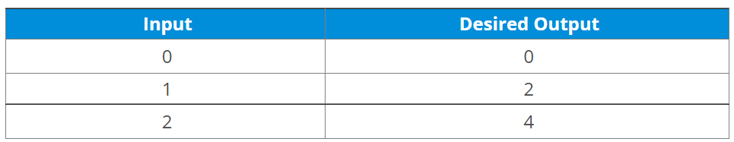
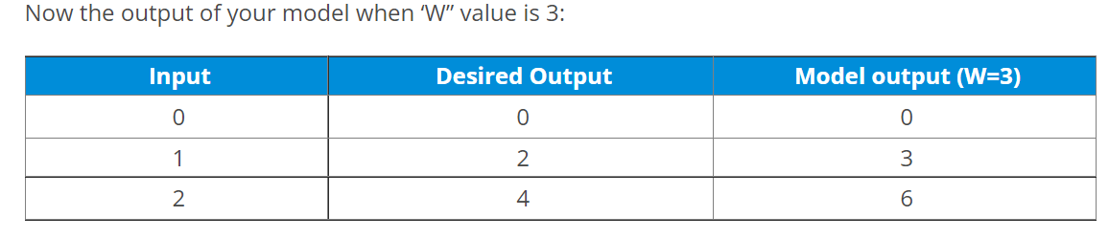
Back Propagation

Slide 10
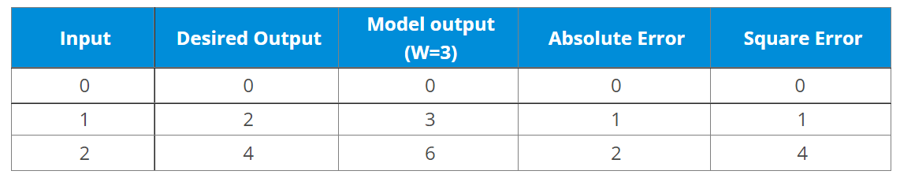
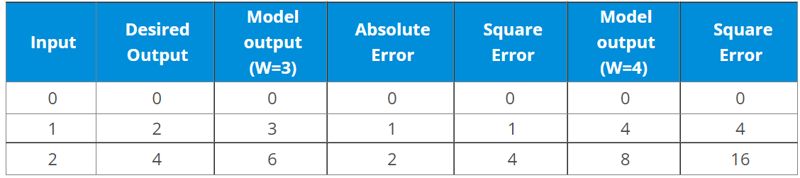
Back Propagation
W3
W4

Slide 11
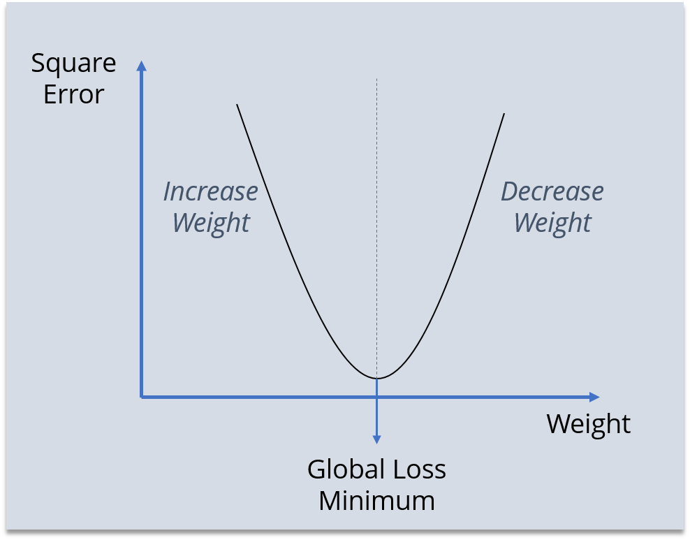
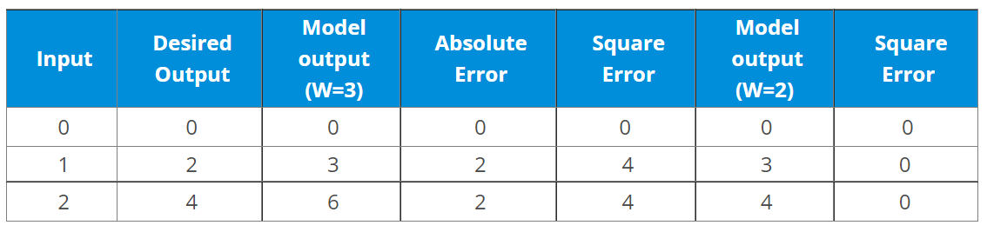
Back Propagation
W2
We first initialized some random value to ‘W’ and propagated forward.
Then, we noticed that there is some error. To reduce that error, we propagated backwards and increased the value of ‘W’.
After that, also we noticed that the error has increased. We came to know that, we can’t increase the ‘W’ value.
So, we again propagated backwards and we decreased ‘W’ value.
Now, we noticed that the error has reduced.

Slide 12
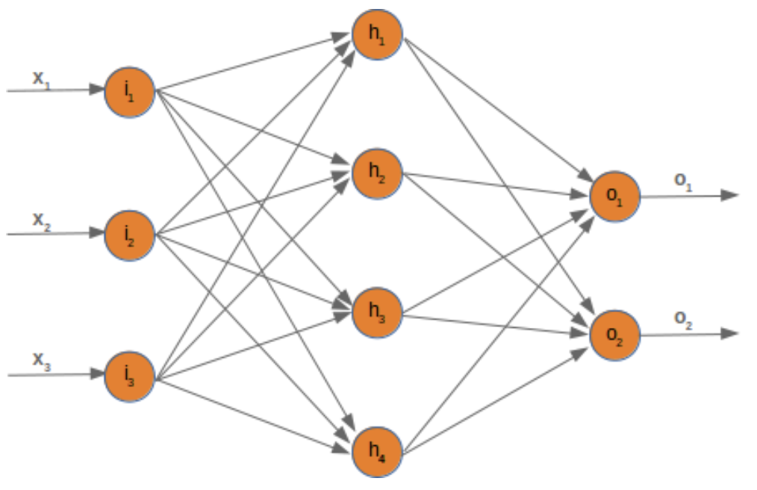
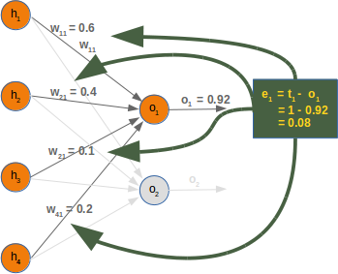
Poll
Q1: Calculate the fraction of the error e1 in w11. Assume that the model is linear.
https://medium.com/@jorgesleonel/backpropagation-cc81e9c772fd

Slide 13
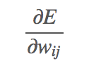
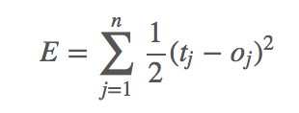
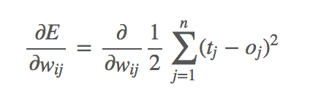
Back Propagation – Non Linear N/W
As we wish to descend, the derivation describes how the error E changes as the weight w changes:
Error function E over all the output nodes oj (j=1,…nj=1,…n) where n is the number of output nodes is

Slide 14
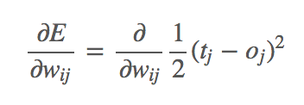
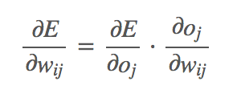
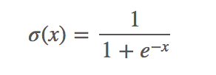
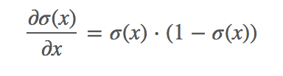
Back Propagation – Non Linear N/W
This is the error for a node j for example:
Applying the chain rule for the differentiation that we learn in Calculus, over the previous term to simplify things:
Sigmoid activation function

Slide 15
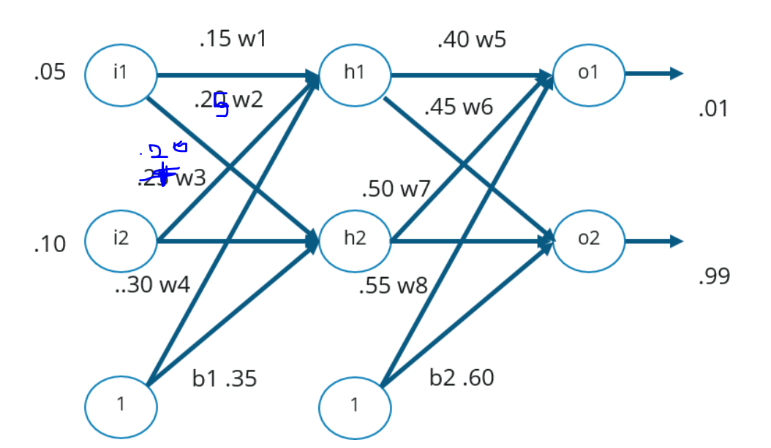
Back Propagation - Example
two inputs
two hidden neurons
two output neurons
two biases
Step – 1: Forward Propagation
Step – 2: Backward Propagation
Step – 3: Putting all the values together and calculating the updated weight value
https://www.edureka.co/blog/backpropagation/

Slide 16
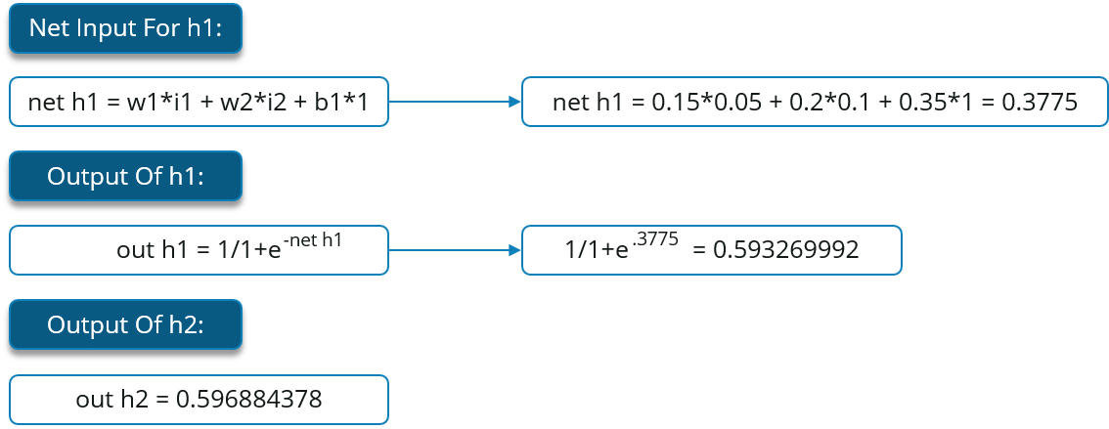
Back Propagation - Example Step 1: Forward Propagation

Slide 17
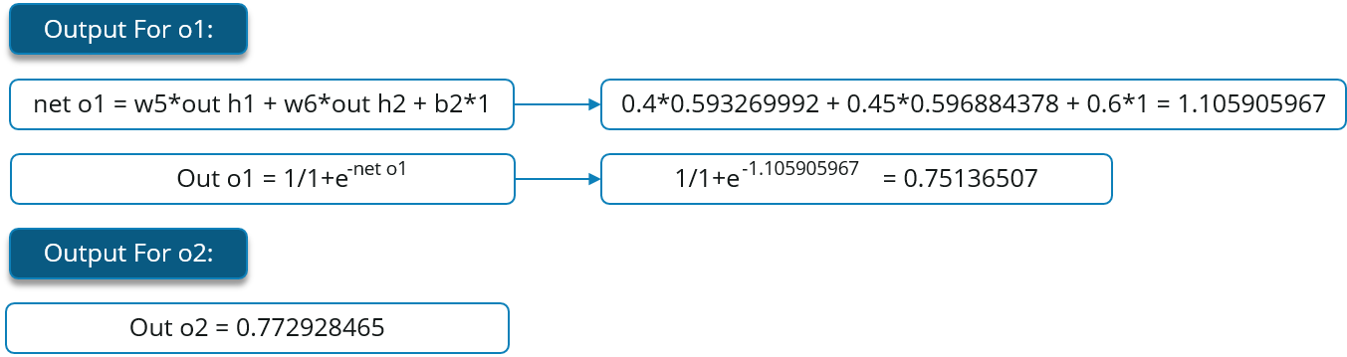
Back Propagation - Example Step 1: Forward Propagation

Slide 18
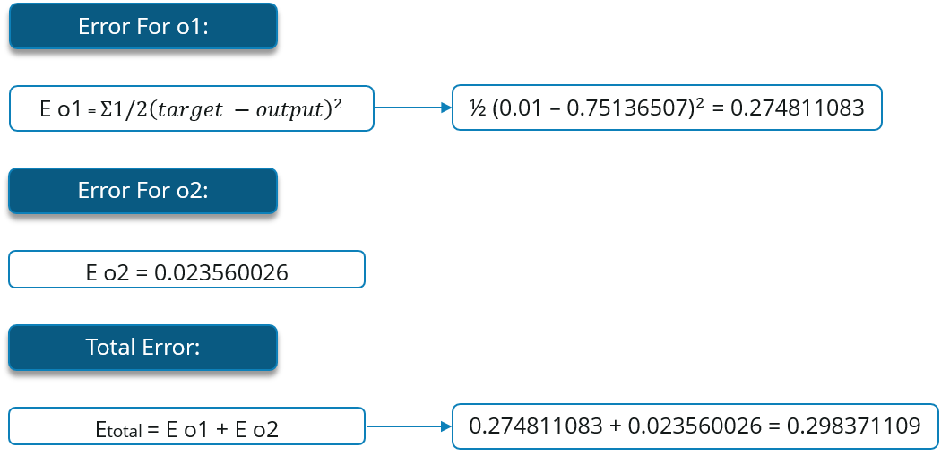
Back Propagation - Error

Slide 19
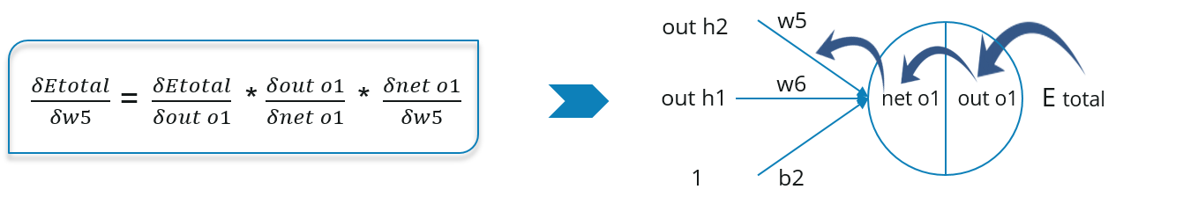
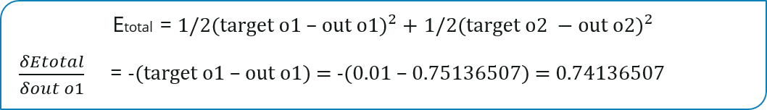
Step2: Backward Propagation
Calculate the change in total errors w.r.t the output O1 and O2.

Slide 20
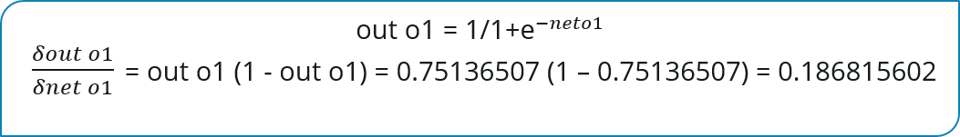
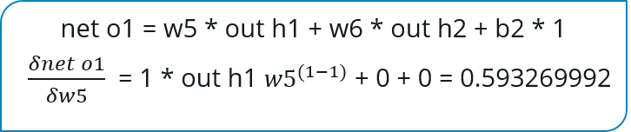
Step2: Backward Propagation
Propagate further backwards and calculate the change in output O1 w.r.t to its total net input.

Slide 21
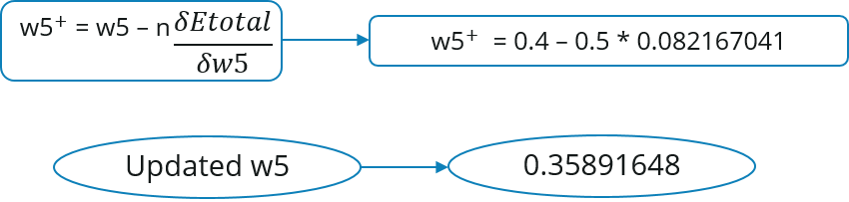
Step3: Update Weight

Slide 22
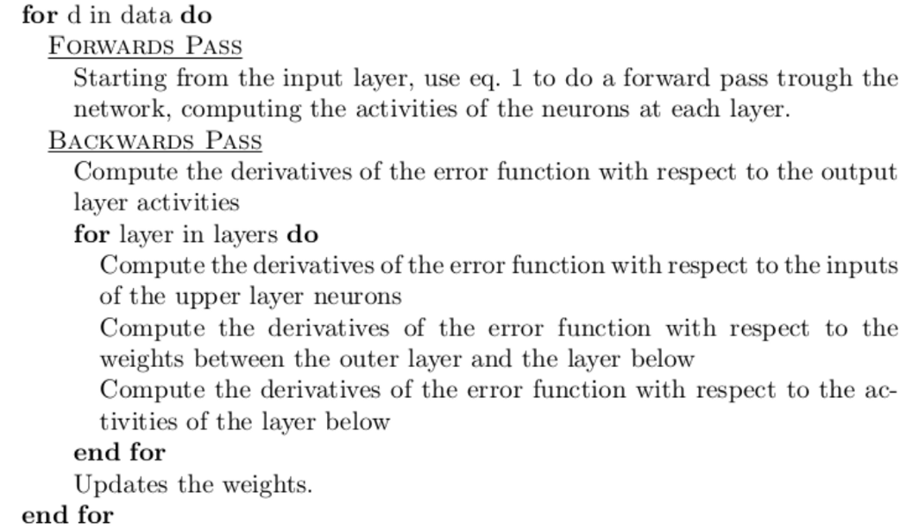
https://medium.com/@jorgesleonel/backpropagation-cc81e9c772fd

Slide 23
Optimizers
Gradient Descent
Most basic but most used optimization algorithm.
First-order optimization algorithm which is dependent on the first order derivative of a loss function.
Algorithm: θ=θ−α⋅∇J(θ)
Advantages:
Frequent updates of model parameters hence, converges in less time.
Requires less memory as no need to store values of loss functions.
May get new minima’s.
Disadvantages:
High variance in model parameters.
May shoot even after achieving global minima.
To get the same convergence as gradient descent needs to slowly reduce the value of learning rate.
https://towardsdatascience.com/optimizers-for-training-neural-network-59450d71caf6
https://peterroelants.github.io/posts/neural-network-implementation-part01/

Slide 24
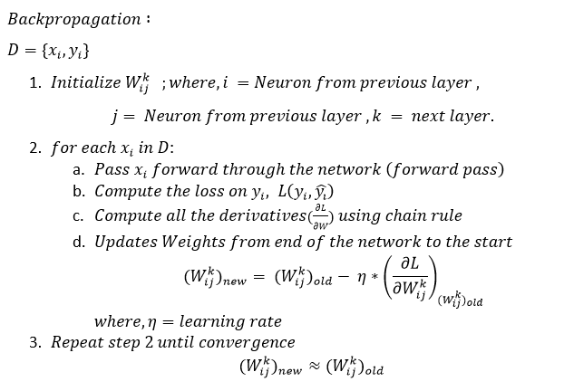

Slide 25
Optimizers
Stochastic Gradient Descent
Variant of Gradient Descent. Update the model’s parameters more frequently.
Parameters are altered after computation of loss on each training example.
Algorithm: θ=θ−α⋅∇J(θ;x(i);y(i)) , where {x(i) ,y(i)} are the training examples.
Advantages:
Easy computation.
Easy to implement.
Easy to understand.
Disadvantages:
May trap at local minima.
Weights are changed after calculating gradient on the whole dataset. So, if the dataset is too large than this may take years to converge to the minima.
Requires large memory to calculate gradient on the whole dataset..

Slide 26
Optimizers
Mini-Batch Gradient Descent
Variant of Gradient Descent. Best among all the variations of gradient descent algorithms.
It updates the model parameters after every batch.
Algorithm: θ=θ−α⋅∇J(θ; B(i)), where {B(i)} are the batches of training examples.
Advantages:
Frequently updates the model parameters and also has less variance.
Requires medium amount of memory.

Slide 27
Optimizers
Momentum
Invented for reducing high variance in SGD and softens the convergence..
It accelerates the convergence towards the relevant direction and reduces the fluctuation to the irrelevant direction.
Algorithm: V(t)=γV(t−1)+α.∇J(θ)
Now, the weights are updated by θ=θ−V(t).
The momentum term γ is usually set to 0.9 or a similar value.
Advantages:
Reduces the oscillations and high variance of the parameters.
Converges faster than gradient descent.
Disadvantages:
Computationally costly.

Slide 28
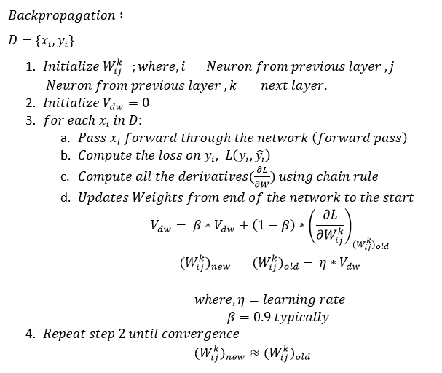

Slide 29
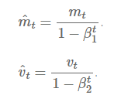
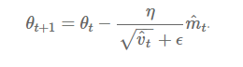
Optimizers
Adam
Adaptive Moment Estimation : works with momentums of first and second order.
Advantages:
The method is too fast and converges rapidly.
Rectifies vanishing learning rate, high variance.
Advantages:
One more hyper-parameter is added which needs to be selected manually and accurately.

Slide 30
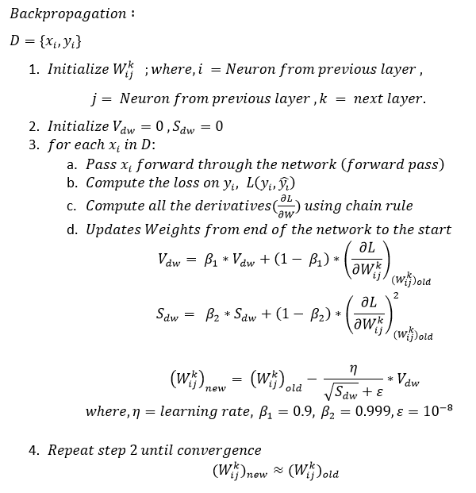

Slide 31
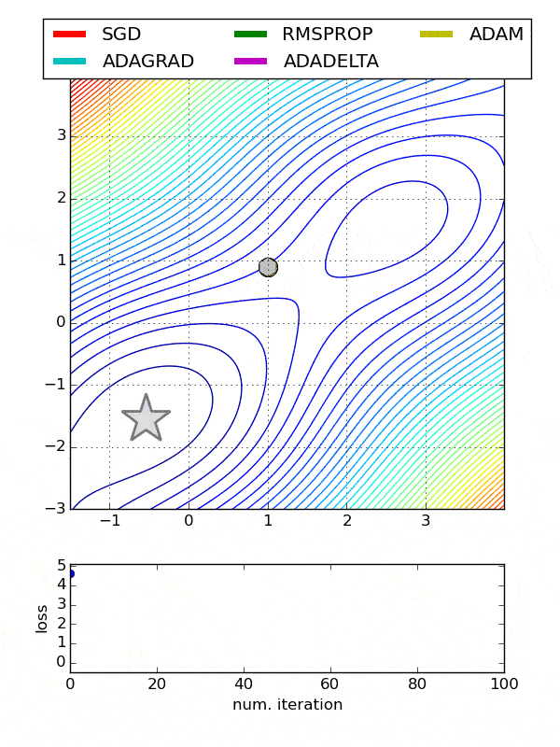

Slide 32
Optimizers
Adam is the best optimizers. If one wants to train the neural network in less time and more efficiently then Adam is the optimizer.
For sparse data use the optimizers with dynamic learning rate.
If, want to use gradient descent algorithm then min-batch gradient descent is the best option.
https://machinelearningmastery.com/implement-backpropagation-algorithm-scratch-python/

Slide 33
https://medium.com/nerd-for-tech/flux-prediction-using-single-layer-perceptron-and-multilayer-perceptron-cf82c1341c33
https://towardsdatascience.com/multilayer-perceptron-explained-with-a-real-life-example-and-python-code-sentiment-analysis-cb408ee93141
https://towardsdatascience.com/activation-functions-neural-networks-1cbd9f8d91d6
https://www.geeksforgeeks.org/activation-functions-neural-networks/
https://medium.com/nerd-for-tech/flux-prediction-using-single-layer-perceptron-and-multilayer-perceptron-cf82c1341c33
https://towardsdatascience.com/how-does-back-propagation-in-artificial-neural-networks-work-c7cad873ea7
https://towardsdatascience.com/optimizers-for-training-neural-network-59450d71caf6
https://www.analyticsvidhya.com/blog/2021/10/a-comprehensive-guide-on-deep-learning-optimizers/

Slide 34
Thank you

